Slide 1
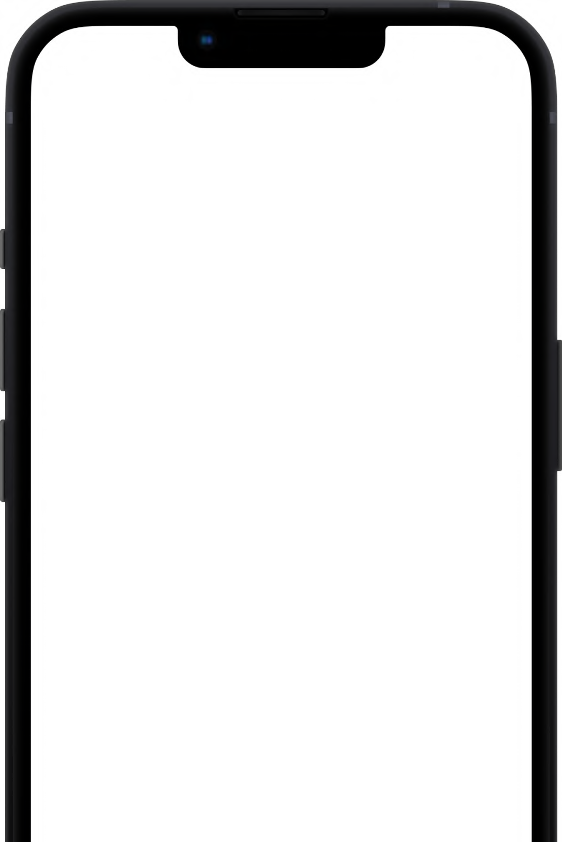
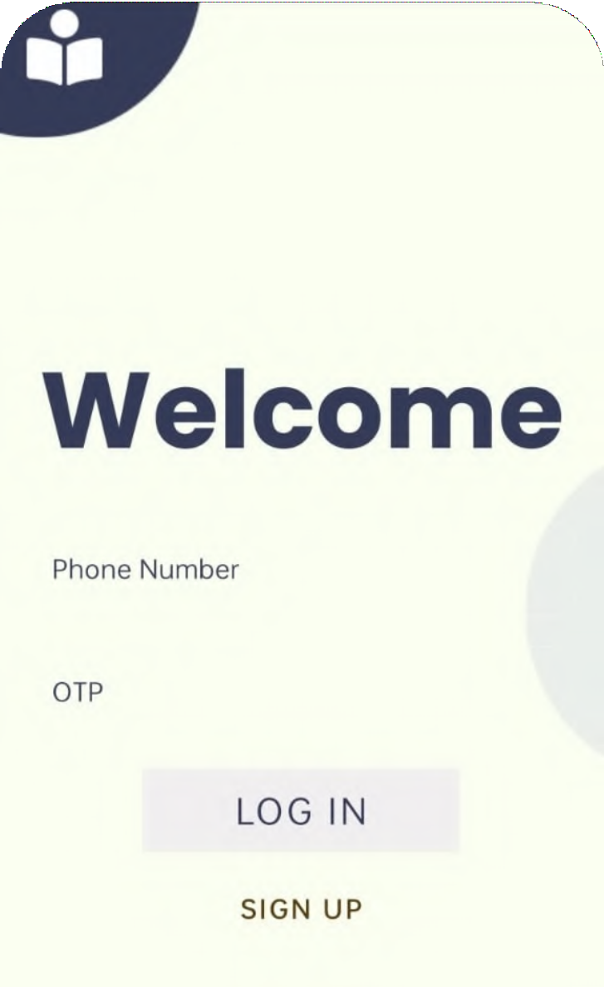

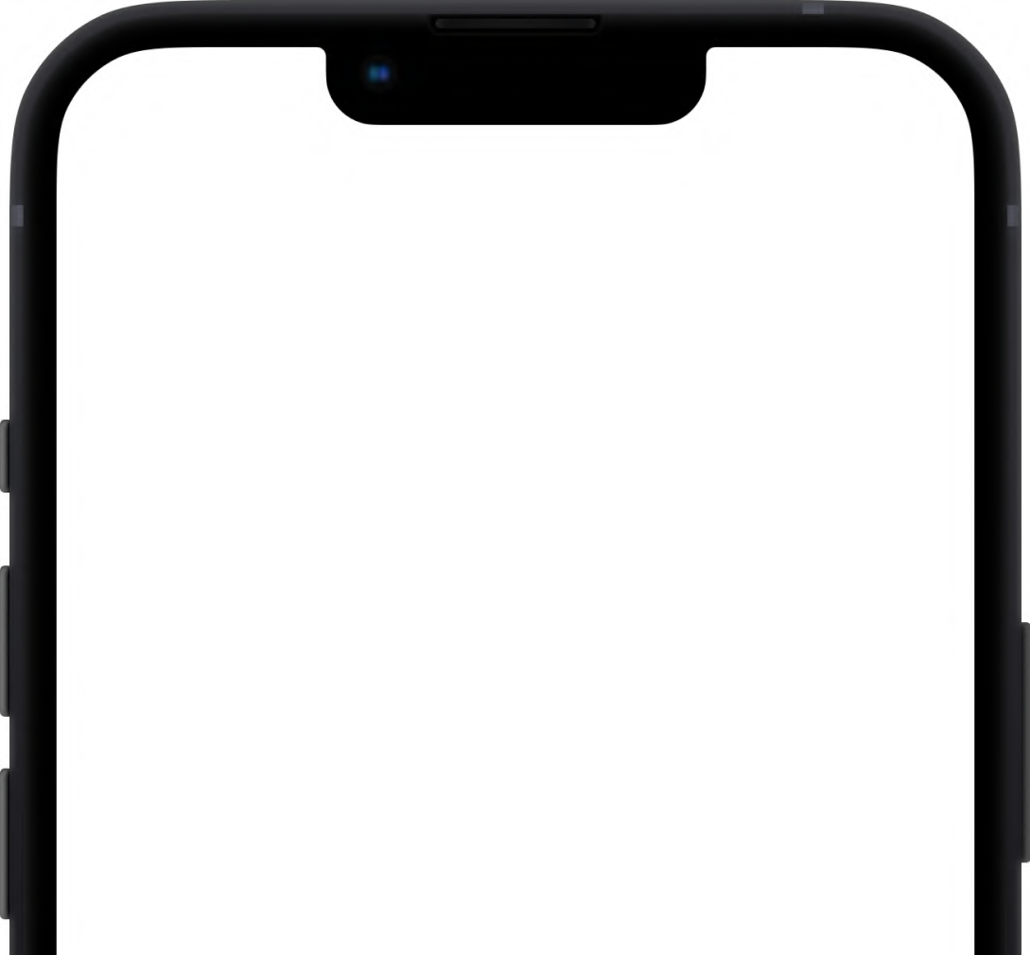

Team Digit X Rajasthan IT Day Hackathon
March 2023
AAWAZ

Slide 2

A CITIZEN CENTRIC APP FOR MITIGATING ROAD SAFETY ISSUES
The problem

Slide 3


WHY SHOULD PEOPLE CARE?
A citizen centric app which will enable people to register any road safety problem, raise an issue or report
any violation through an app. This app will help to prevent many accidents.

Slide 4
HERE'S THE BEST PART
Rather than writing an entire complaint, just upload a photo which will be classiﬁed by our app.

Slide 5
4,22,659
‘Trafﬁc Accidents’ in the country
THE NUMBERS
Many of these deaths occur because of unreported accidents as the didn't get medical attention on time for them to survive.
Share of ‘Trafﬁc Accidental Deaths’ in Accidental Deaths due to ‘Other Causes’
44.5%
complaints about bad roads
22000

Slide 6
INTRODUCING
AAWAZ

Slide 7


Raise your
AAWAZ
today.

Slide 8


THE MISSION
Fast & accurate registration of road safety issues
Timely report generation
Prompt medical care in case of accidents
Removal of spam ﬁlings

Slide 9
BE A PART OF THE ERSS
Emergency Response Support System (ERSS) is a Pan-India single number (112) based emergency response system for citizens in emergencies. Each State/Union Territory is required to designate a dedicated Emergency Response Centre (ERC) to handle emergency requests. If you require emergency assistance from Police, Fire, or Health departments or any other services, you may:
Dial 112 from your phone;
Press the power button on your smartphone 3 times in quick succession to activate a Panic call;
Long press the ‘5’ or ‘9’ key on your feature phone to activate Panic call;
SMS to 112 from your phone;
Log on to the State ERSS website and place your SOS request;
Email SOS alert to Emergency Response Centre in the State
Use the 112 India mobile app (available on the Google Play store and Apple store) to activate a panic call.

Slide 10
OUR APPROACH
We need to be a part of the state ERSS system to give the fastest possible response to any sort of emergency. To do this,
we need to get permission from each state government and, along with them, implement a system where we can send the authorities the location and urgency of the matter.
We will link the app with the ERSS system and hence develop a fast response system to any accident or emergency
The idea of integrating an emergency response system into a mobile app is a good one, and it could potentially save lives in emergencies.
Furthermore, the technical implementation of the system would need to be carefully planned and executed to ensure
that it is secure, reliable, and able to handle a large volume of emergency requests. The app would need to accurately and quickly relay information about the location and urgency of each emergency to the relevant authorities.
It is important to note that emergency response systems typically involve a complex network of trained professionals, equipment, and resources.

Slide 11
WHY WE ARE AGAINST VIOLATION REPORTING
This approach could violate the privacy of the person. Everyone has a right to privacy, and taking a photo of them without their consent and uploading it publicly can infringe on their rights.
Secondly, there is a risk of misidentiﬁcation. People may look similar, and an innocent person could be wrongly identiﬁed and ﬁned. This could cause undue stress and ﬁnancial harm to the wrongly accused person.
-the photo might be staged
-not describing the complete scenario
-not reliable for ﬁning people in general
In summary, ﬁning someone based on a picture without proper legal procedures and privacy considerations is not a valid approach. It is best to follow established legal procedures and let the authorities handle the situation.

Slide 12
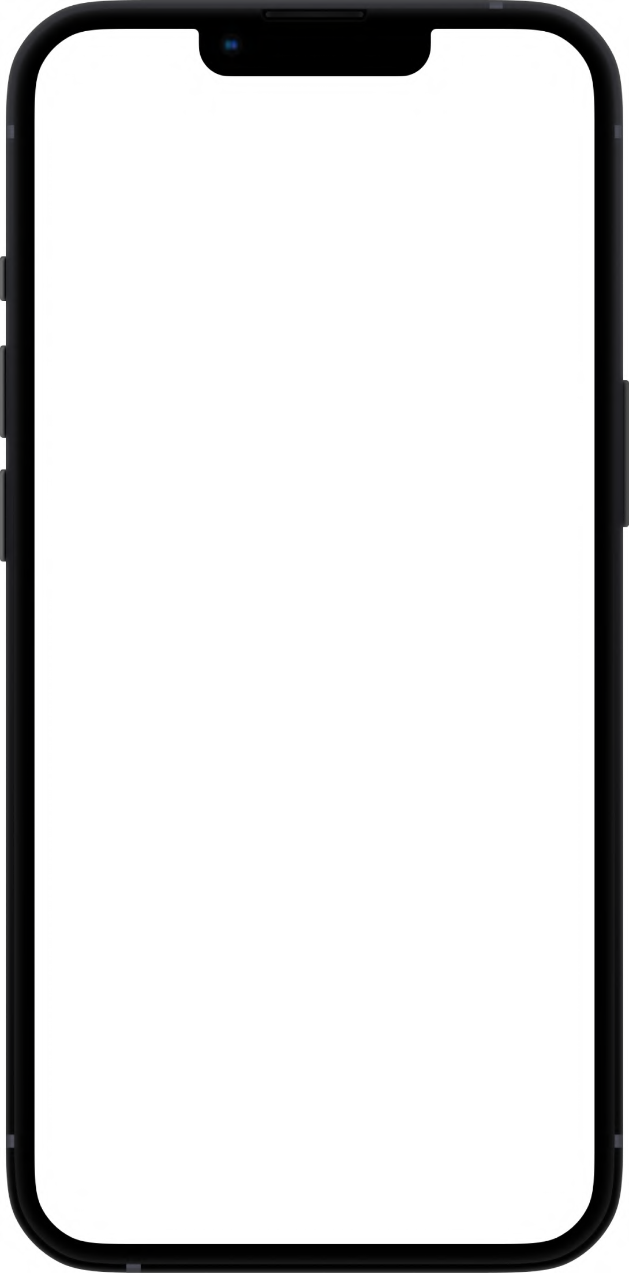


BENEFIT #1
User friendly interface
Robust design

Slide 13

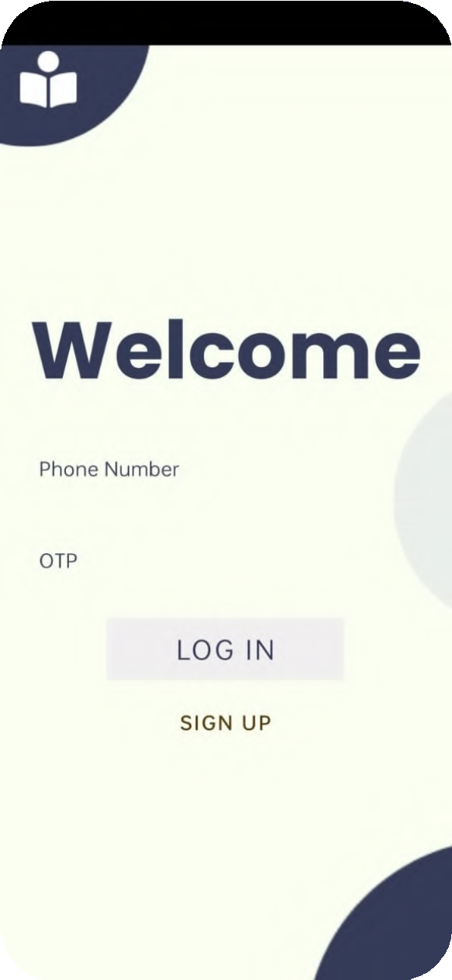

BENEFIT #2
Easy REGISTER on our app
Only mobile no. is required

Slide 14

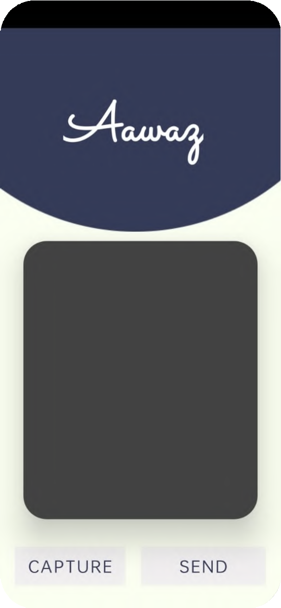
BENEFIT #3
Simple steps to raise your voice:
Just allow location
Open up the camera
Take a snap
Our app will do the rest

Slide 15
PRODUCT DIFFERENTIATORS
Differentiator #1
Differentiator #2
Differentiator #3
The use of image for accident/complaint classiﬁcation rather than writing the whole complaint in detail
We use ML model to classify which can learn and grow progressively
Too simple to use

Slide 16
WHO CAN USE THIS APP?
EVERYONE

Slide 17
FUTURE SCOPE
Future expansion of this app can include
a sophisticated system to log all types of complaints not restricting the app to just road safety,
and expanding it to social well-being.
This can be a bridge between the people and the local authorities.

Slide 18
Anuneet Rastogi
Azzam Husain
Ayam Bhura
Tanmay Tripathi
Aditya Pramar

Slide 19
THANK YOU

